Slide 1
Fatigue Design of Structures
G. Hénaff
1

Slide 2
Damage tolerance

Slide 3
Damage Tolerance
introduction

Slide 4
DT Motivations
On Dec 22nd 1969, a F-111 fighter aircraft lost a wing during a training flight (2 pilots dead).
Origin of the failure: forging flaw introduced during the first processing operations but not detected at the time of manufacture
This accident triggered the largest survey ever conducted on a single material, in this case the D6AC steel but almost highlighte dthe need to take into account the presence of a flaw in the structure

Slide 5
Standard Design
Simplified Wöhler curve
Reference loading R=0.1
Fatigue Quality Index (IQF):
S_{max} (R=0.1) at 10⁵ cycles
Log (
σ
)
max
σ
max
(R)
p
σ
max
(0,1)
R=0,1
R
Log (
Ν
)
10
5

Slide 6
Standard Design (cont’d)
with

Slide 7
Standard Design (cont’d)
M : influence of material ;
E : scale effect ;
T : influence of technological processes
T₁ : influence of surface treatment ;
T₂ : influence of mechanical treatment ;
T ₃ : influence of the type of joining for bolted or riveted assemblies ;
T₄ : Influence of adjustments for bolted joints .
K_{t} : stress concentration factor ;
C : Influence of the structural configuration (accidents of form, assemblies, lugs).

Slide 8
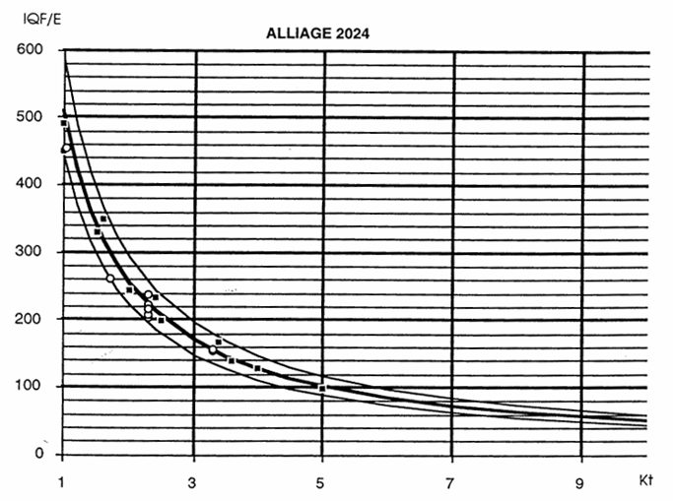
Standard Design (end)

Slide 9
Motivation
Flaw size
Failure
Full scale testing
Initial flaw
Target life
x 2
x 3
x 4

Slide 10
Damage Tolerance
Objectives

Slide 11
Objectives
Any structure must be able to withstand, at any time during its use, a limit load fixed during the initial design. Thus, an exceptional effort with a low probability is considered, but this should not lead to the ruin of the structure. The limit load will therefore be defined as the product of the exceptional effort by a safety factor (typically 1.5).
In the presence of cracks, the resistance is lower than the initial resistance estimated during design.
Damage tolerance thus determines the ability of a structure to withstand the presence of damage in the form of cracks without catastrophic consequences, even for exceptional effort until the damaged part is detected and repaired or the structure reaches the end of its life.

Slide 12
Outputs
DT Analysis must provide:
the evolution of residual strength as a function of crack size;
the permissible crack size;
the propagation time from the detection threshold;
the permissible initial defect size in a new structure;
the interval of inspection or replacement.

Slide 13
Tasks of the DT analysis
Define the range of use of the structure
Develop the spectrum of load factors
Identify critical points
Establishing the stress spectrum for each point
Identify the environment for each point
Establishing the cracking data

Slide 14
Tasks of the DT analysis (cont’d)
Validate the crack growth analysis;
Determine the fracture toughness for each material and geometry;
Validate the residual resistance analysis methods;
Bring together all the partners concerned and collectively define the inspection methods and their periodicity

Slide 15
DT Analysis
Load spectrum
Computation of SIF
Fracture toughness data
σ
K
K_{c}
K_{Ic}
t
Thickness
Propagation computation
Residual strength
σ
da/dN data
a
da/dN
R₃ >R₂ >R₁
Fatigue life assesment
a
ΔK
Time, number of flights

Slide 16
DT assessment
Update
DT assessment
Identification
of critical points
DT analysis
Geometry of defects
Damage detectability
Validation by tests on structural details and full-scale structure
In-service measurements
Load spectrum
Propagation calculations
Validation by tests on specimens
Inspection period
Inspection interval
Field experience

Slide 17
Damage Tolerance
Residual strength

Slide 18
Residual strength
Structural strength
Updated strength after repair
NDT
Extreme load
VISUAL
Limit load
Inspection period
Regular loads (flight efforts)
Time

Slide 19
Residual strength
Flaw size
Critical flaw size
Detection threshold
Inspection interval
Time
Inspection period

Slide 20
Residual strength
Flaw size
Initial resistance
Residual strength
a_{p}
Propagation Life
σ _{p}
σ_{max}
a₀
a_{i}
H
Flaw size
Time
a_{p}
a_{c}
t₁
t₂
a_{i}: initial flaw size
a₀: NDT detection threshold

Slide 21
Application
Flaw size
Multiple load paths
Crack arrester
2
2
2
1
1
Inspection period
Inspection period
Value at the limit load
Value at the limit load
Critical size at limit load
Critical size at limit load
Value of « sure » detection
element
1
element
1
2
element
2
element
Number of flights

Slide 22
Application
Flaw size
To be assessed in safe life
Non damage-tolerant structure
Damage Tolerant Structure with unique load path
inspection period
Value of « sure » detection
Taille critique
à la charge limite
Critical size at limit load
Value of « sure » detection
Number of flights

Slide 23
Toughness data as a function of thickness

Slide 24
Residual strength of a panel
Residual strength σ_{f}
Crack size a

Slide 25
Residual strength of a stiffened panel
rivets
2a
2r
(a)
2r
2r
(b)
2 a
(c)
2 a

Slide 26
Residual strength of a stiffened panel
rivets
Residual strength σ_{f}
2a
Position of the stiffener
2r
Non stiffened panel
Crack size a

Slide 27
Example of residual strength diagram

Slide 28
Damage Tolerance
Different options

Slide 29
Options
periodic inspections: repair if flaw detection;
"Fail Safe" design: repair if partial failure;
Leak Before Breakage Design: Pressure Vessels
Durability design: replacement or withdrawal after time H;
Proof test (destructive test): repair if rupture during the test.

Slide 30
Periodic inspection
Flaw size
Damage
at the limit load
Visual examination
Sophisticated NDT techniques
Short inspection period BUT low cost NDT means
Long inspection period BUT expensive NDT means
Fatigue life

Slide 31
Fail Safe

Slide 32
Leak before breakage (LBB)
B
A
B
Wall thickness
Through crack
2c

Slide 33
Proof test
a _{d}
a _{p}
a _{proof}
H
N ou Time
(a)
s _{residual}
s _{residual}
Nominal residual strength
s _{proof}
Residual strength during proof test
Room Temperature
s _{p}
s _{proof}
Low temperature
a _{proof}
a _{p}
Crack size
a _{proof}
a _{p}
Crack size
(b)
(c)

Slide 34
Damage Tolerance
Calculation of propagation life

Slide 35
Integration
Δa
Crack length, a

Slide 36
Iterative computation
Initialisation
a
j
=
a
0
;
N
=
0;
a
i
=
a
j
β
=
⎛
a
i
⎞
i
f
⎜
W
⎟
⎝
⎠
Δ
K
i
=
β
i
×
σ
i
×
π
a
i
⎛
da
⎞
=
(
)
⎜
⎟
F
Δ
K
i
,
R
,...
⎝
dN
⎠
i
Δ
a
i
=
δ
a
i
(
0
.
01
mm
for
example
)
Δ
N
=
(
Δ
a
i
)
i
da
dN
i
N
j
=
N
i
+
Δ
N
i
a
j
=
a
i
+
Δ
a
i
if
(
a
<
a
)
continue
j
c

Slide 37
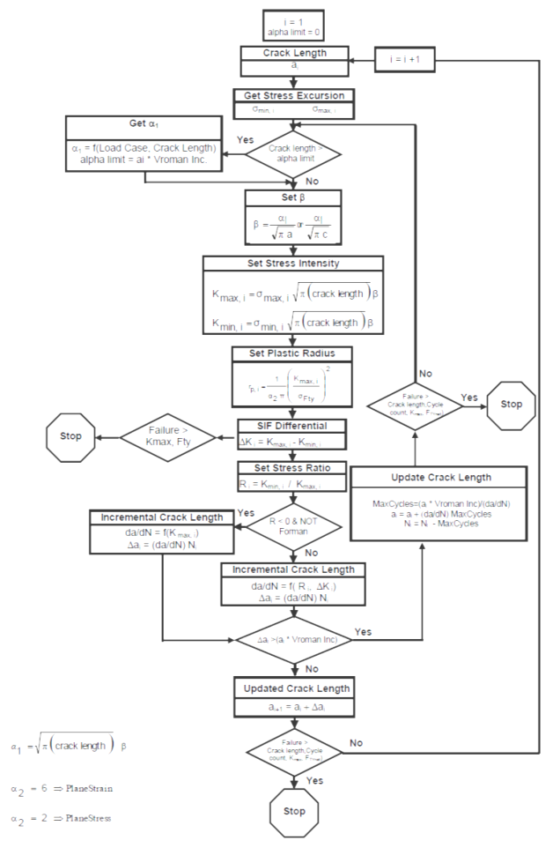
AFGROW Flowchart

Slide 38
Walker equation

Slide 39
Walker equation

Slide 40
Forman equation
McEvily - Forman

Slide 41
NASGRO equation
The f function accounts for closure effects
Threshold function :

Slide 42
NASGRO: closure

Slide 43
NASGRO: Threshold
2024 T351

Slide 44
NASGRO

Slide 45
Sources of error
Error | Source | Comment | Factor on predicted fatigue life
LEFM Intrinsic Limitations |  | Small error for small cracks or small components | 1.1 - 2
Input data | K_{Ic} or K_{c} ou autre | Error on a_{p} | 1.1-1.2
 | da/dN | Natural scatter | 1.1-1.5
 | Environment | Weight average | 1-2
 | Crack growth equation | Adjustment | 1.5
Assumptions | Crack growth direction (ex. LT vs SL) | Use of erroneous data | 1-2
 | Initial flaw size | Strong influence | 1-3
 | Shape | Surface flaws | 1-2
Stress Intensity Factor | Loads/Stresses | Measurements | 1-1.5
 |  | Analysis | 1-1.5
Load History | Sequence | Random or semi-random | 1.5
 | Truncation | Inadequate truncation | 1.1-1.3
Retardation | Model | Small if well calibrated | 1.1-1.3
 | Stress state | If not taken into account | 1.1-1.5
 | Yield strength | For example 10% too low | 1.5-2.0

Slide 46
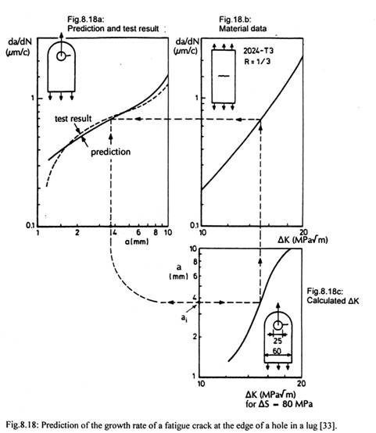
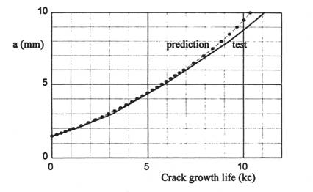
Example: crack growth in a lug
Procedure:
Consider an initial default size a_{i};
Determine the ΔK in the screed for a = a_{i};
For this value read the corresponding crack growth rate;
Report the growth rate on the da / dN = f (a) diagram
The curve da / dN = f (a) must be integrated to obtain a = f (N)

Slide 47
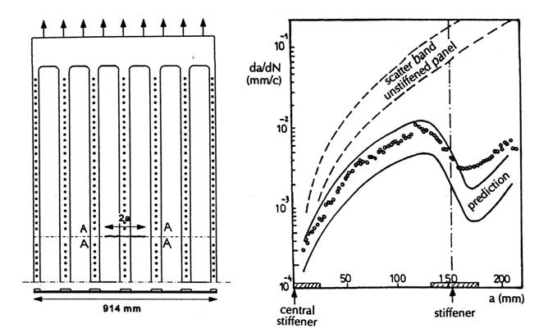
Example 2: stiffened panel
2024 T3, R=0.1
Crack initiated in the central bay

Slide 48
Damage Tolerance
Variable amplitude loading - Retardation

Slide 49
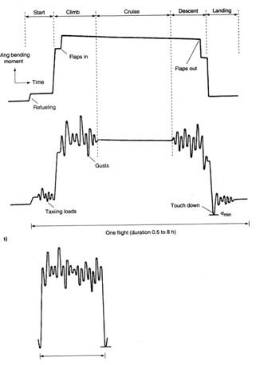
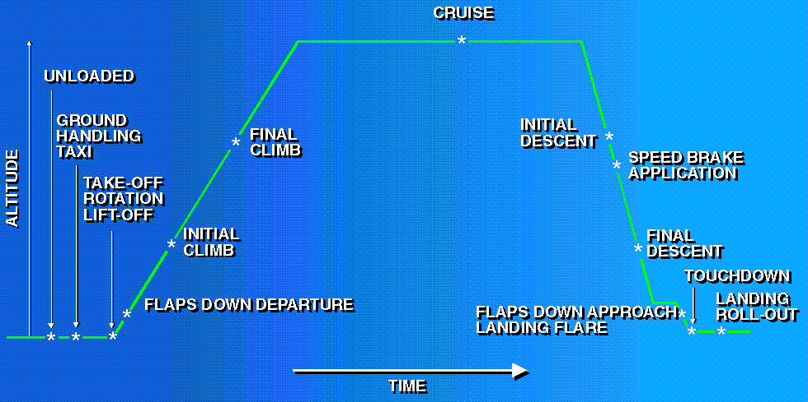
Load spectrum during a flight

Slide 50
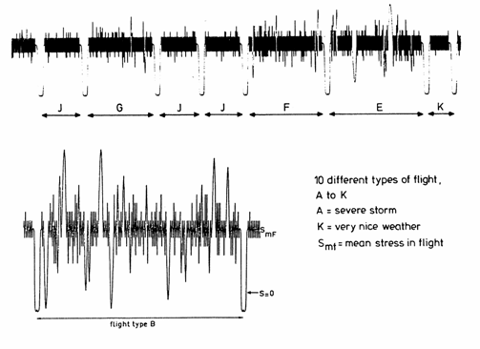
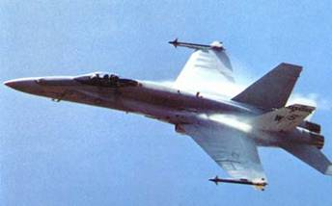
Spectrum of a F-18 fighter aircraft wing

Slide 51
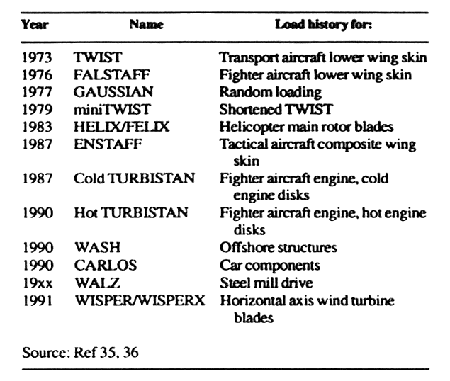
Standard load spectra

Slide 52
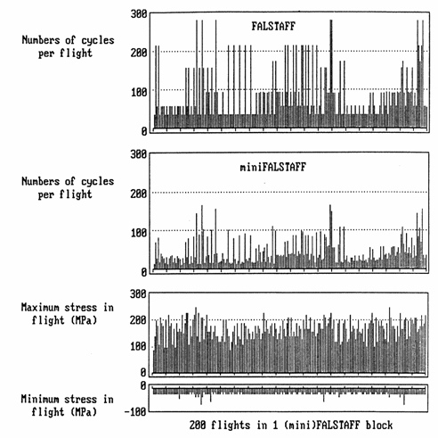
FALSTAFF

Slide 53
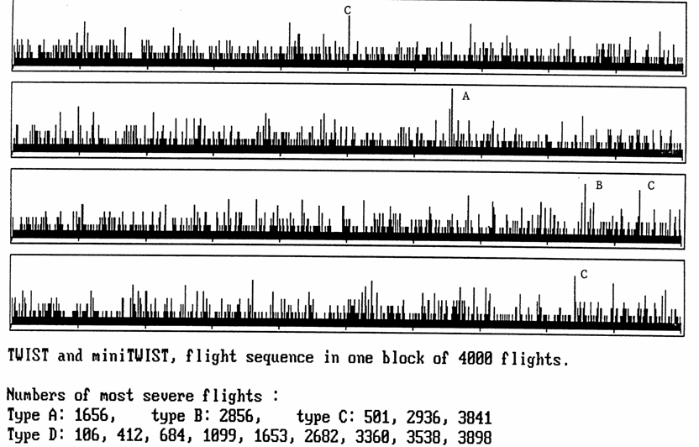
TWIST

Slide 54
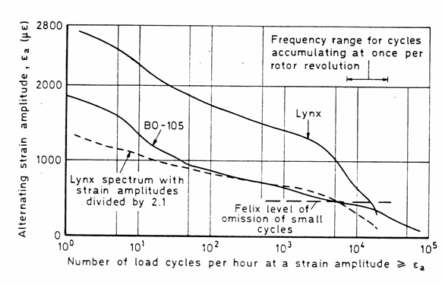
HELIX/FELIX
The distribution of cycles depends on the type of aircraft

Slide 55
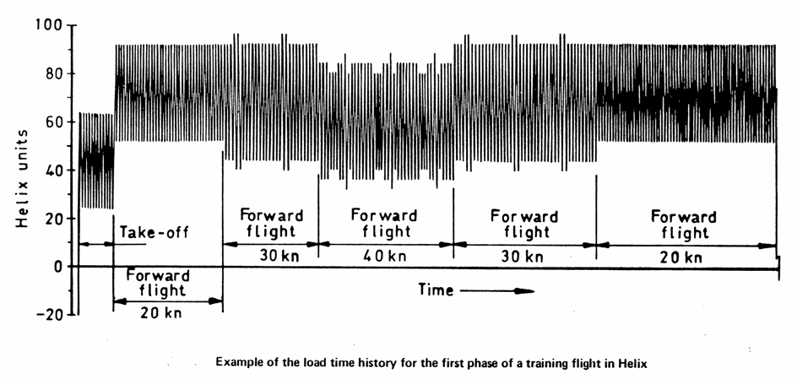
HELIX

Slide 56
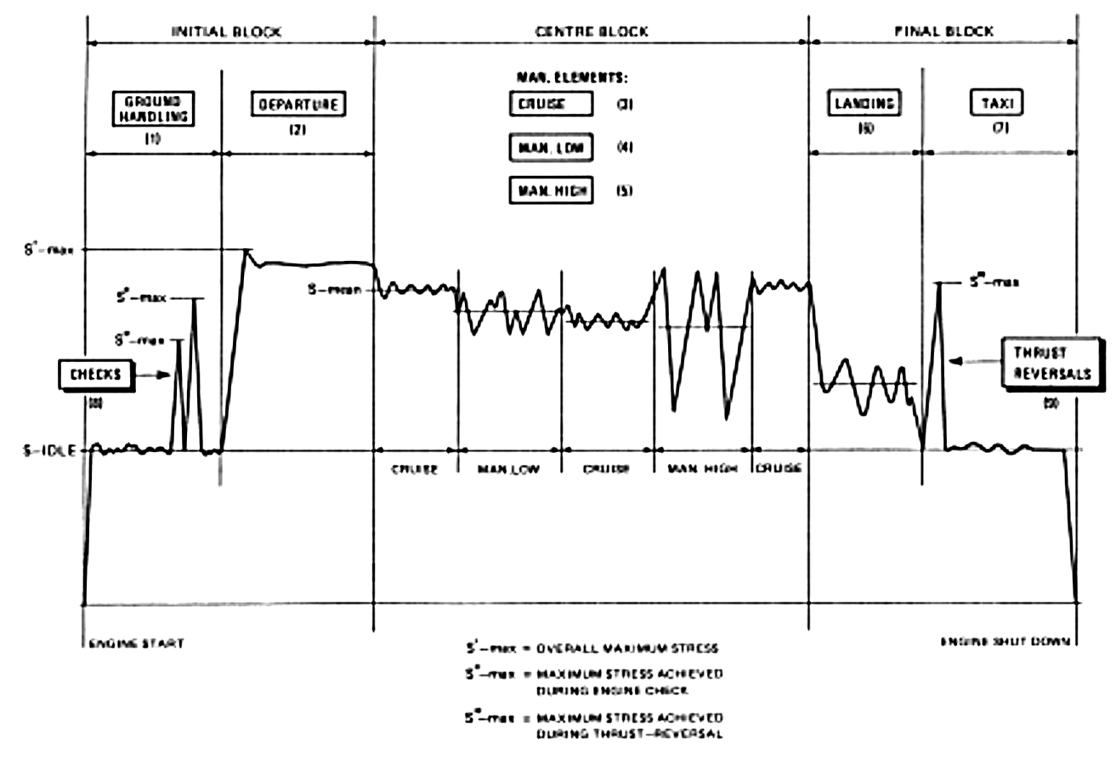
TURBISTAN

Slide 57
TURBISTAN

Slide 58
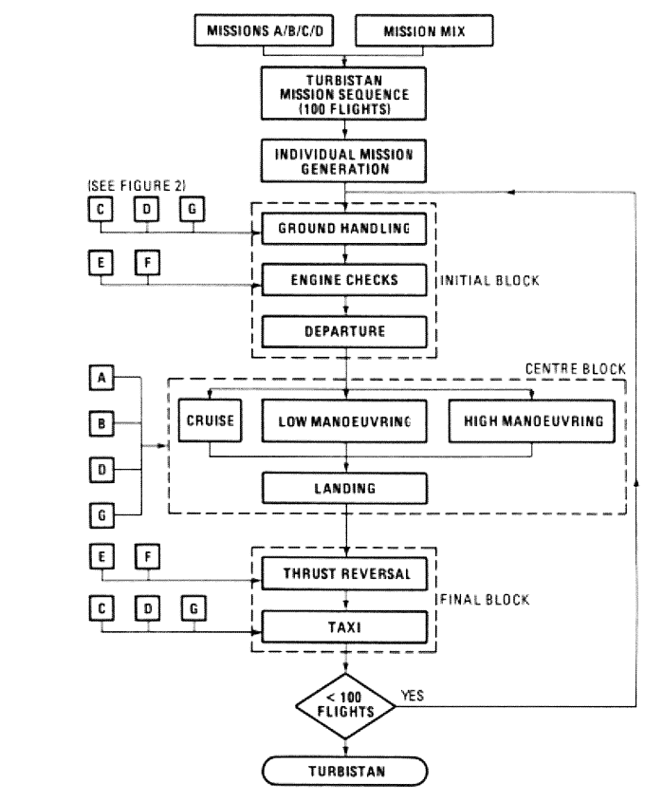
TURBISTAN

Slide 59
Load history effects

Slide 60
Markings on fracture surfaces

Slide 61

Overload

Slide 62
Retardation
a
a
da/dN
da/dN
S
S
N
N
(a) No retardation
(b) Retardation
a
a
da/dN
da/dN
S
S
N
N
(c) Delayed retardation
(c) Lost retardation

Slide 63
Characteristic retardation parameters
a
da/dN
(da/dN)₀
S
a_{R}
(da/dN)_{min}
S
N_{R}
N
a
N₀
N_{S}
a*
a_{R}

Slide 64
Retardation mechanisms
The effect of residual stresses induced by the overload in front of the crack tip;
An increase in the crack closure effects induced by the material highly stretched during the overload and subsequently passed in the crack wake;
A crack tip blunting which would reduce the magnitude of stresses sustained at the crack tip assimilated to a micro-notch;
Crack tip hardening of the material induced by the overload.

Slide 65
Overload/underload
a
N

Slide 66
Wheeler model
a_{i}
β_{i}
R₀
a₀
R_{peak}
Plastic zone interactions

Slide 67
Willenborg model
a_{i}
R_{eq}
R₀
K_{R}: SIF required to create a PZ with a size R_{eq} defined by:
a₀
R_{peak}
Retardation predicted if a load ratio effect is noticed on the da/dN curves.

Slide 68
PREFFAS
P
P
P_{max ref}
P_{min ref}
t
t
n cycles
n_{eq} cycles
CAL equivalent sequence

Slide 69
PREFFAS
At cycle i, the crack growth is given by:
Δa_{i} = C x ΔK_{eff} ^{m} = C x (K_{max, i} ‑ K_{op,i})^{m}
where C and m are the Paris law coefficients de la loi de Paris.
The value of K_{op, i} depends on the load history and is determined by a Elber relation :
K_{max, i} ‑ K_{op,i} = U x (K_{max}‑ K_{min})
With: U(R)=A x (K_{max, H} / K_{min, H} )+B
Where K_{min, H} et K_{max, H} are values representative of the load history.

Slide 70
PREFFAS

Slide 71
PREFFAS
The prediction of the propagation under variable amplitude loading therefore only requires the determination of 4 parameters:
C and m, the coefficients of the PARIS law
A and B, the coefficients of the ELBER relation
These 4 coefficients are derived from two tests
1 under constant amplitude loading R=0.1
1 under similar baseline loading with the introduction of an overload at τ = 1.7 every 1000 cycles.

Slide 72
PREFFAS

Slide 73
PREFFAS

Slide 74
PREFFAS
Pylon spectrum

Slide 75
FASTRAN
S_{max}
S_{min}
y
y
x
x
c
ρ
c
ω
W
W
ασ₀
ασ₀
σ
x
σ
x
−σ₀
−ασ₀
−ασ₀
(a) Max stress
(b) Min stress

Slide 76
FASTRAN

Slide 77
FASTRAN

